Slide 1

Coco-Cola Retailer Analysis

Slide 2
BUSINESS OVERVIEW
The data set is a Coco-Cola’s business in the United States for the year 2021.It consists of transactions with various retailers selling its beverages Examples of the categories of retailers include supermarket, convenience stores, and wholesale clubs. The retailers are sodapop, bevCo and fizzySip

Slide 3

TOOL USED EXCEL

Slide 4
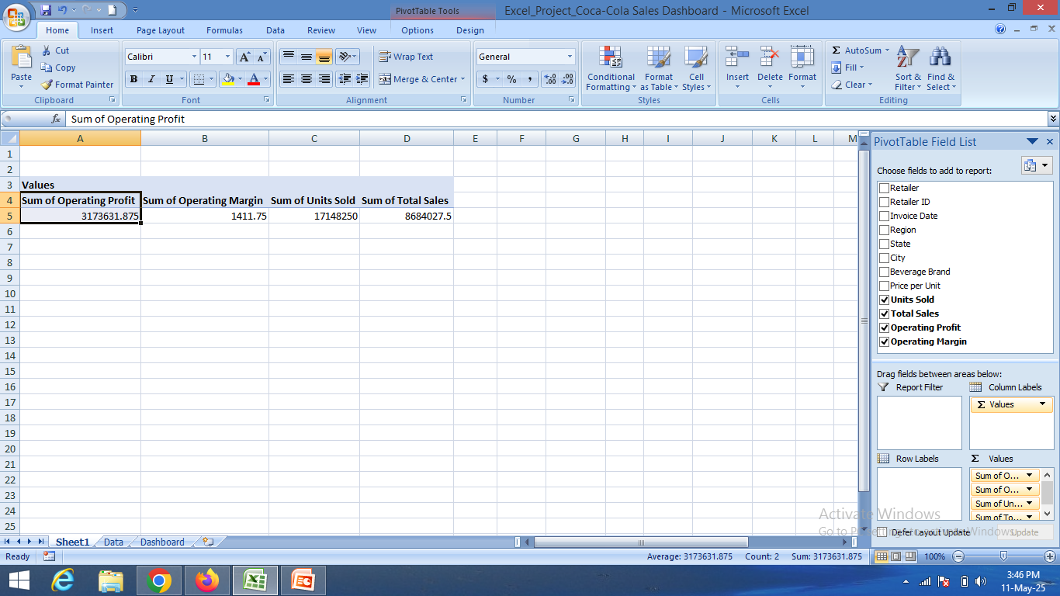
First Step
Create a pivot table
Add a operating margin,operating profit,total sale, and total units in the values
Those 4 margin,profit,total sales and units are numeric
so we should add in values

Slide 5
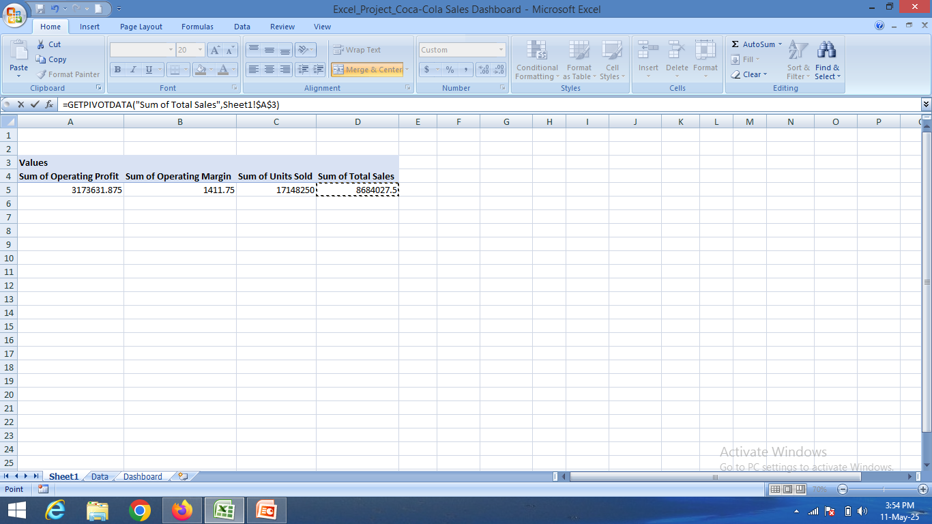
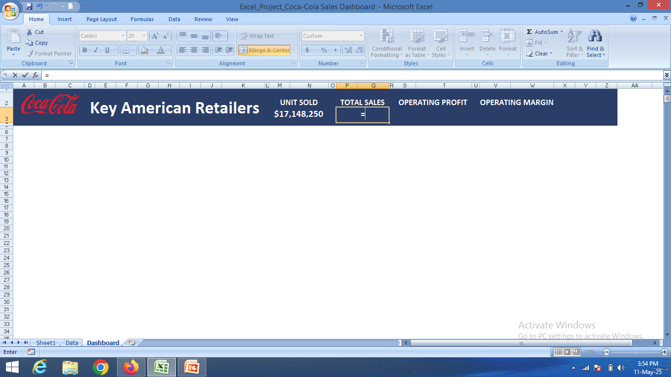
Second step
Add the unit sold,sales,operating margin,and profit in the dashboard
Give a “=“ symbol and go to the sheet where we created a pivot table click on the particular value and press enter
Example:

Slide 6
Third step
Create a pivot table for month and sum of units sold
Add unit sold in values
Add invoice date in rows and remove the date when you get month
And click on the pivot table and create a chart

Slide 7
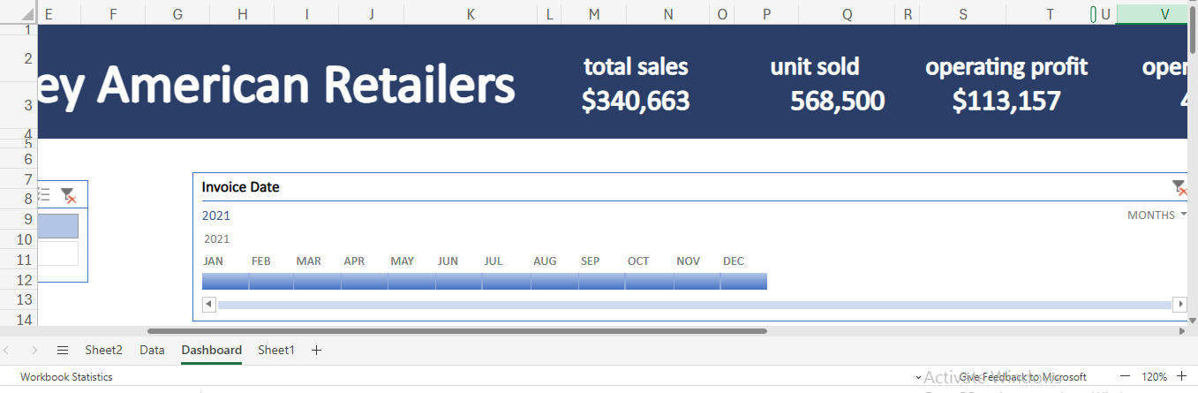
Fourth step
Creating a PivotTable Timeline:
1. Insert a PivotTable:If you don't have a PivotTable, create one from your data.
2. Analyze > Insert Timeline:Click on a cell within your PivotTable, go to the "Analyze" tab, and select "Insert Timeline".
3. Select Date Fields:In the "Insert Timeline" dialog box, check the boxes for the date fields you want to use for filtering, and click "OK".
4. Filter Data:Use the timeline controls (e.g., dragging handles, selecting time periods) to filter your PivotTable data by date.

Slide 8
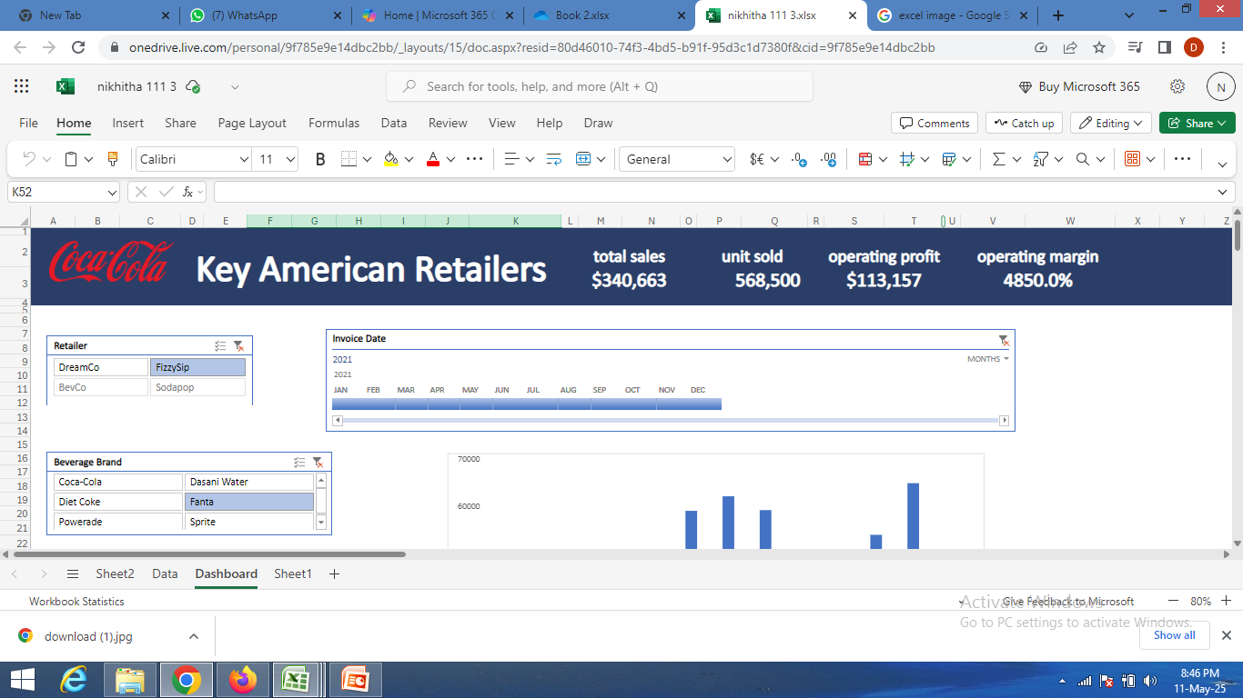
Fifth step
Here's a general outline of how to add a slicer:
Choose a Tool: Determine if you are using Excel with PivotTables or Power BI.
Create the PivotTable/Data Source: If using Excel, create a PivotTable from your data. In Power BI, ensure your data is loaded and connected.
Select the PivotTable/Report: In Excel, click anywhere within the PivotTable. In Power BI, navigate to the report page where you want the slicer.
Insert Slicer:Excel: Go to the "Insert" tab, then "Slicer". Select the fields you want to filter by.

Slide 9
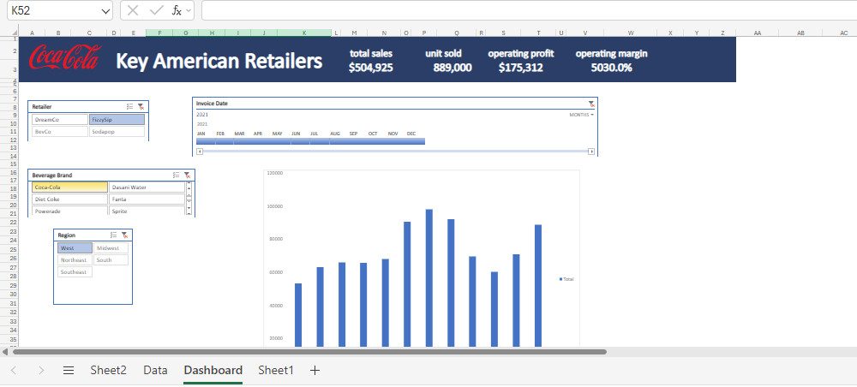
Sixth step
Steps to Connect:
Create a PivotTable: Select your data, go to "Insert" > "PivotTable".
Insert Slicer: Go to "Analyze" > "Insert Slicer" and choose the field you want to filter (e.g., category, region).
Insert Timeline: Go to "Analyze" > "Insert Timeline" and choose the date field you want to use.
Create PivotChart: Go to "Analyze" > "PivotChart" and choose a chart type.Report Connections (Optional): Select the slicer, go to "Slicer Tools" > "Options" > "Report Connections" and select the PivotChart to connect it.
Test and Adjust: Interact with the slicer and timeline to see how they filter the PivotChart data.

Slide 10
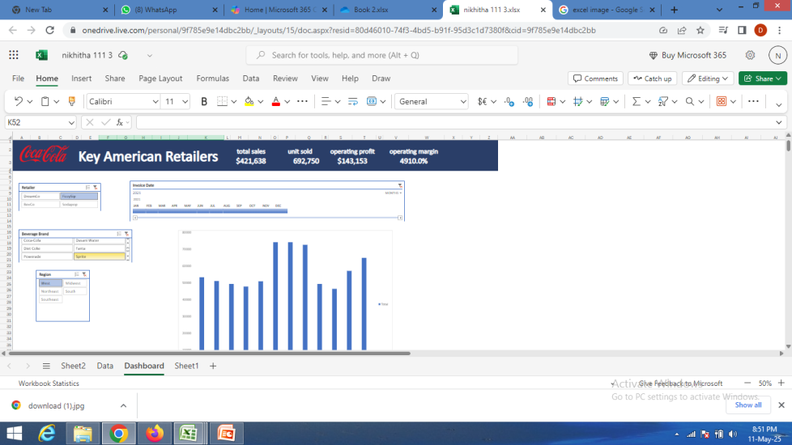
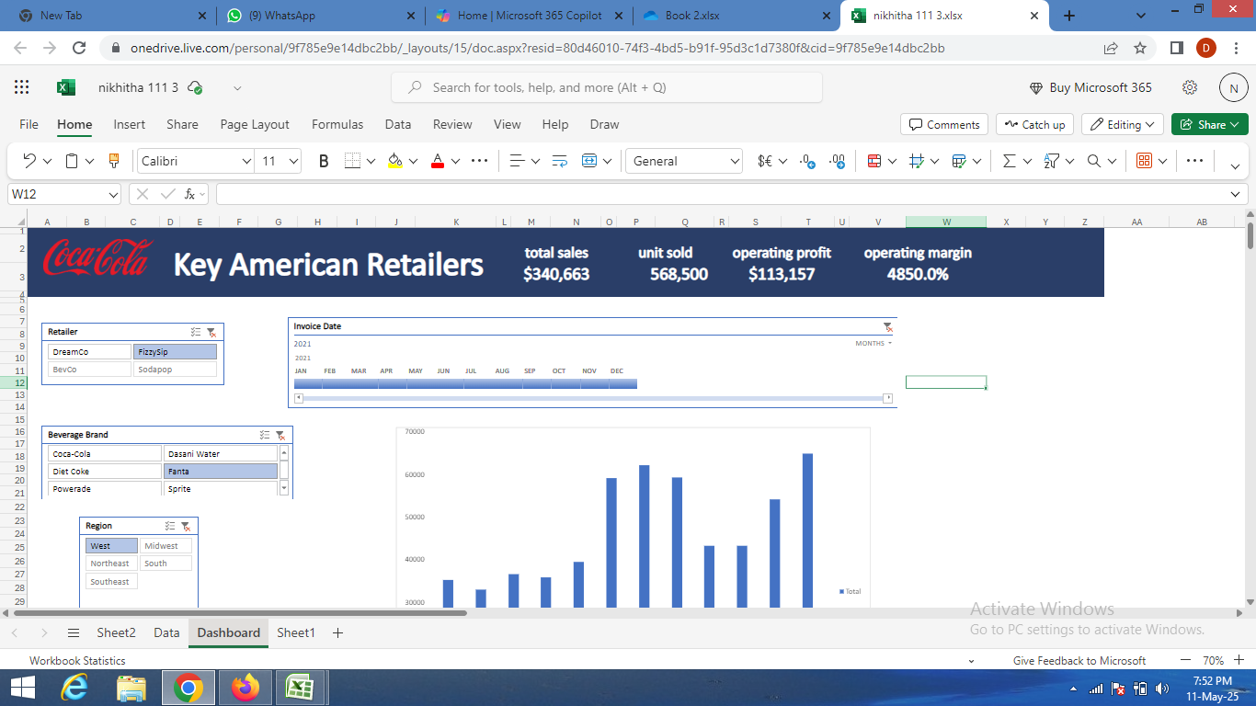
Sales Analysis

Slide 11
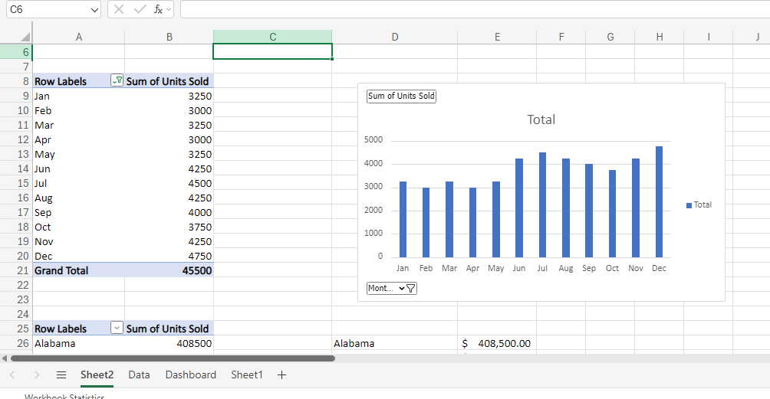
Monthly Sales Report

Slide 12
Thank You
Keerthana M

